Slide 1
Faculty Senate Meeting
October 22, 2020

Slide 2
Meeting procedure
The same rules apply over virtual meetings as over in-person meetings
Only Senators may debate motions
Only Senators can vote
If you are not a Senator, or a proxy, you cannot vote or debate
Do not speak over someone, or out of order
  Raise your hand within the Zoom app
  The President will call on you and then you will have the floor
Unless you have been recognized (been told you have the floor), you may not speak

Slide 3
Agenda
Call to Order and Roll Call
K. Dolan, Secretary

Slide 4
Agenda
Approval of Minutes
September 10, 2020

Slide 5
Agenda
III. Campus Reports
  A. Staff Council, A. Kossuth

Slide 6
Agenda
III. Campus Reports
  B. Student Council, L. Hierlmeier

Slide 7
Agenda
IV. President’s Report
S. Raper

Slide 8
General Items
Nuclear Engineering and Radiation Science approved as independent program.
Formation of two ad hoc committees - laboratory space related and responsibility for support of obsolete equipment and or software.
Open forums for Provost finalists: Oct 19, 21, 27, and 29. 9-10 a.m.
Policy open forum III-26 - Distance Education – Educational Fees, 20 Oct, 1 – 2 p.m.
Policy open forum III- 13 – Use of Cameras, 23 Oct, 2 – 3 p.m.
Coach Open Forum held 23 Sept. Slides and Zoom recording on Provosts web-site

Slide 9
IFC – 10/09/2020
Last meeting – 10/09/2020
IFC/ISC – Discussion of resolution prepared by ISC expressing appreciation for faculty and staff as well as future dissemination
  ASUM requests faculty cancel, excuse, or modify classes on election day
CRR for IFC input – Faculty Leave, Ability to Work, Dismissal for Cause
Discussion on “spring break”, commencement
On-Line certification
IT – Beth Chancellor (work habit and cultural changes, technology improvements, annual report)

Slide 10
Agenda
V. Administrative Reports
A. Chancellor’s Report
M. Dehghani

Slide 11


Slide 12
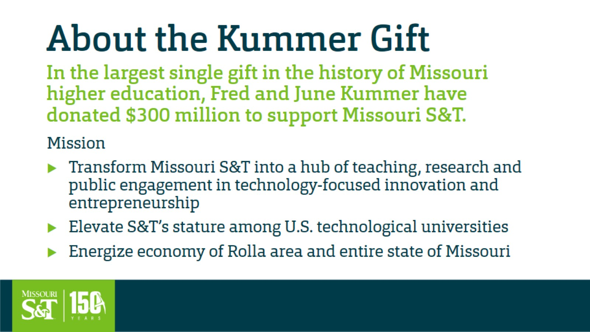
About the Kummer Gift

Slide 13
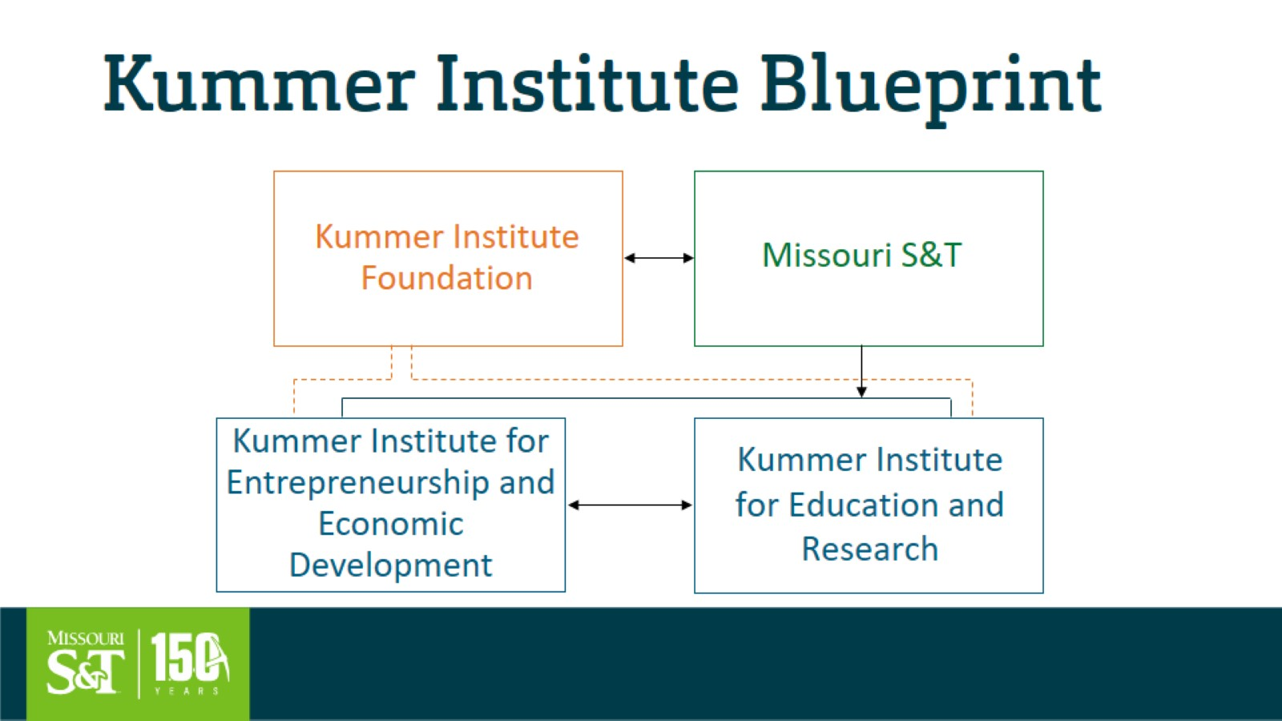
Kummer Institute Blueprint

Slide 14
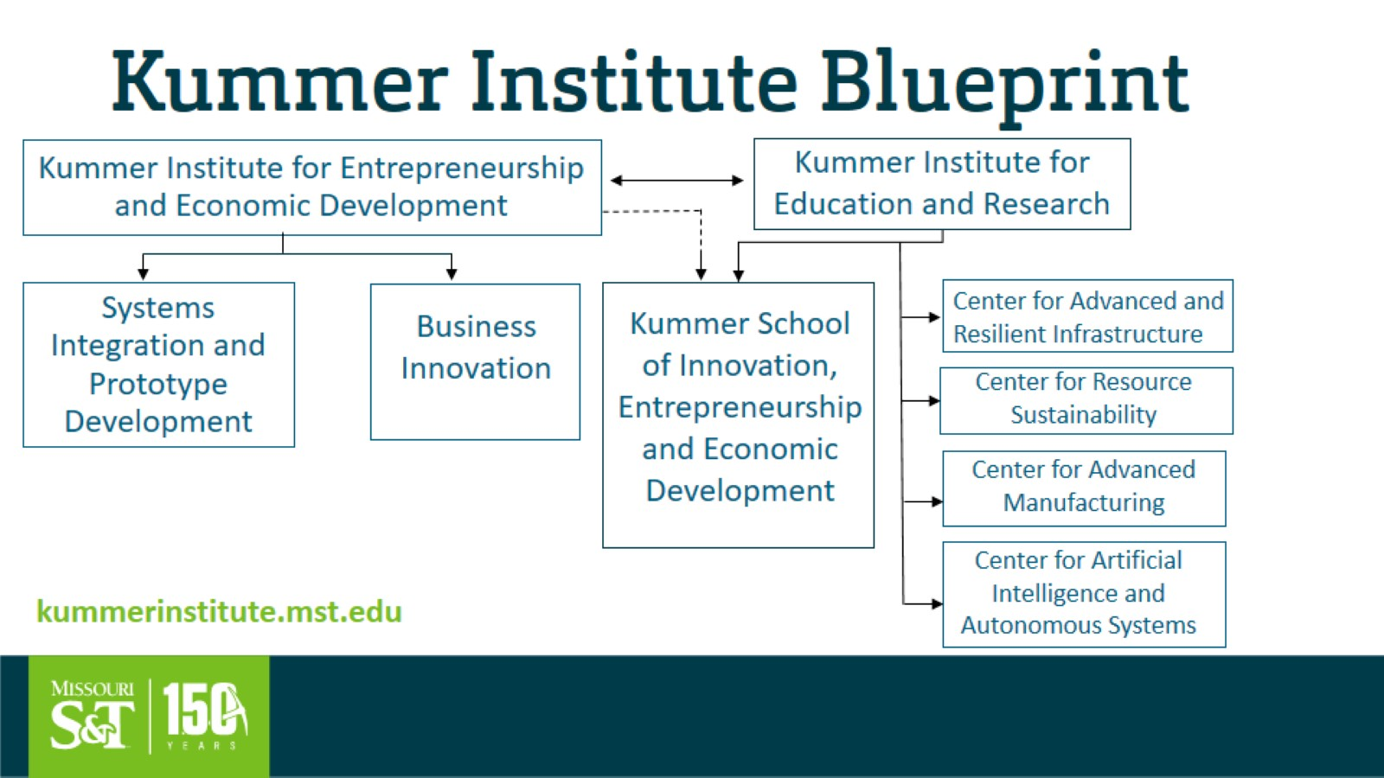
Kummer Institute Blueprint

Slide 15
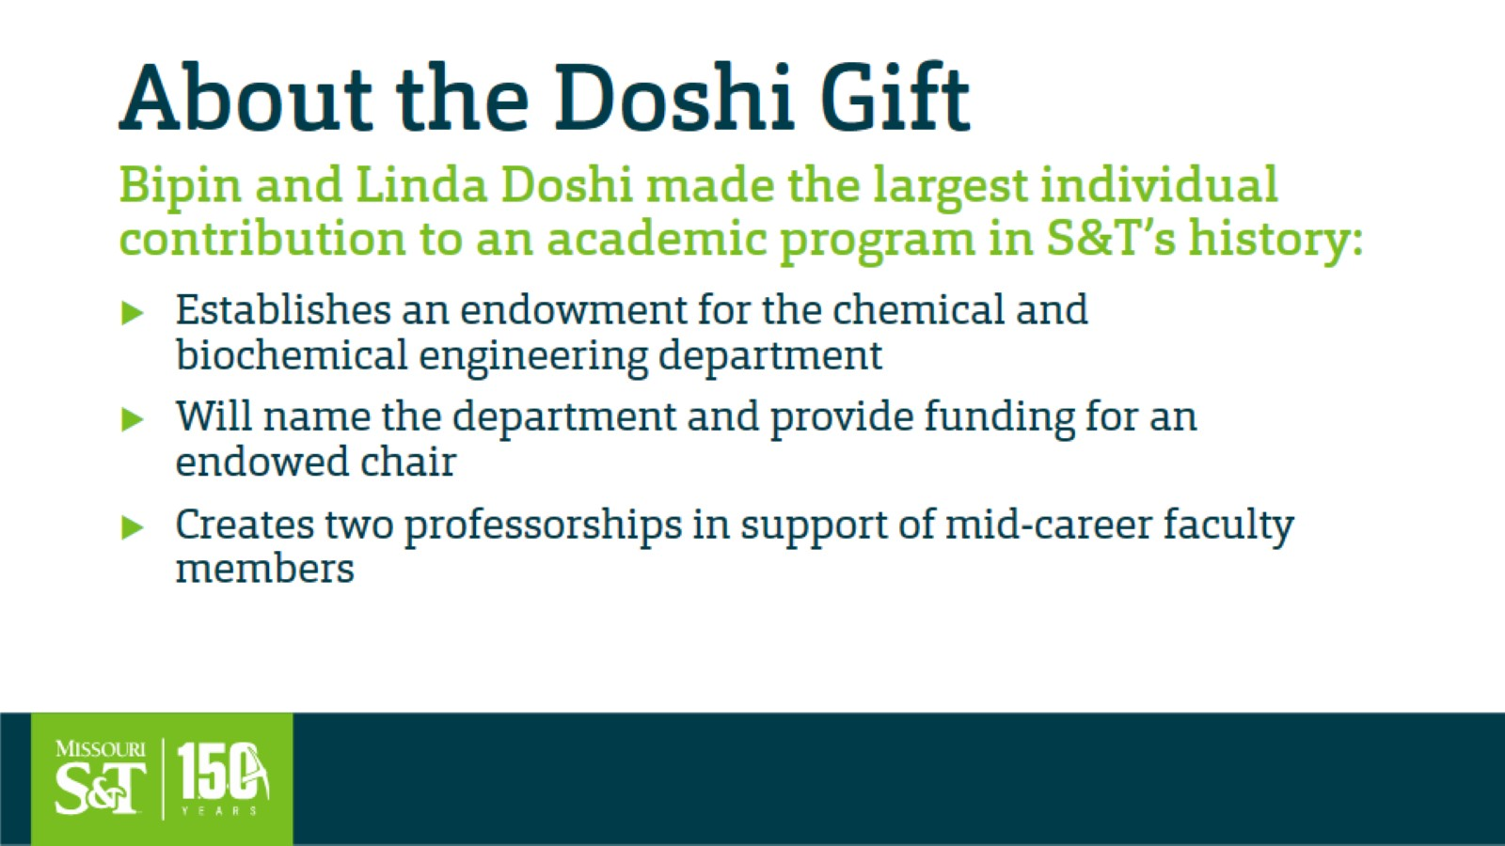
About the Doshi Gift

Slide 16


Slide 17
Agenda
V. Administrative Reports
B. Provost’s Report
S. Roberts

Slide 18

Interim Provost’s Report to Faculty Senate
October 22, 2020

Slide 19
Online Teaching Certification
UM System eLearning Academic Council and the Online Faculty Advisory Committee developed a list of certification options to fulfill the existing, UM System-wide requirement that instructors teaching online courses be certified to do so prior to teaching online.
Required for individuals teaching online courses, including semester-based and self-paced, synchronous and asynchronous courses.
S&T faculty can satisfy the requirement by completing any of the following by September 20, 2021:
  ~20hrs of effort over a 6-wk Online Teaching Certification Seminar by September 20, 2021, OR
  “Start Here 101: Online Course Design Basics” and “Start Here 102: Best Practices in Online Instruction”, OR
  A graduate degree or certification in online learning, educational & instructional technology, or learning systems & design, OR
  Certification through a national organization such as the Association of College and University Educators (ACUE), Quality Matters (QM), or Online Leaching Consortium (OLC), OR
  Similar online training at another university, plus the UM System recertification program, OR
  Have at least 5 years of online teaching experience, plus the UM System recertification program.

Slide 20
Enrollment Trends
2015-2020
Undergraduate
Masters
Doctoral
-11.1% since 2015
-12.1% since 2017
-34.5% since 2015
No change since 2015
-15.4% since 2018
# of Students
Year (4th week census)

Slide 21
Enrollment Trends
Numbers of students enrolled in undergraduate major
(numbers include students who have a 2nd major)
Program 2017 2020 Abs Δ % Δ
Aero Eng 232 275 43 18.5
Applied Math 72 94 22 30.6
Env Eng 68 82 14 20.6
Inf Sci & Tech 122 136 14 11.5
History BA/BS 37 47 10 27.0
Multidisc St 32 39 7 21.9
Tech Comm 25 29 4 16
Philosophy 2 5 3 150
Chem BA/BS 83 84 1 1.2
Civil Eng 359 356 -3 -0.8
Elec Eng 349 343 -6 -1.7
Arch Eng 125 118 -7 -5.6
Bus & Mgt Sys 118 109 -9 -7.6
Eng Mgt 208 194 -14 -6.7
Growth (+8% or more)
Stable (-7.9 to +7.9%)

Slide 22
Enrollment Trends
Numbers of students enrolled in undergraduate major
(numbers include students who have a 2nd major)
Program 2017 2020 Abs Δ % Δ
English 21 14 -7 -33.3
Psych BA/BS 74 66 -8 -10.8
Metal Eng 62 50 -12 -19.4
Physics 99 80 -19 -19.2
Geol Eng 81 60 -21 -25.9
Cer Eng 109 87 -22 -20.2
Comp Eng 259 232 -27 -10.4
Biol BA/BS 256 226 -30 -11.7
Chem Eng 331 299 -32 -9.7
Econ BA/BS 72 39 -33 -45.8
Nuclear Eng 92 58 -34 -40.0
Geo & Geophy 80 41 -39 -48.8
Mining Eng 92 49 -43 -46.7
Comp Sci 684 620 -64 -9.4
Mech Eng 833 738 -95 -11.4
Petrol Eng 140 36 -104 -74.3
All combined, these majors have lost 15.6% of their enrollment since 2017.
Loss (-8% or more)

Slide 23
Enrollment Trends
Numbers of students enrolled in Master’s programs
Program 2017 2020 Abs Δ % Δ
Systems Eng 47 61 14 29.8
I/O Psych 28 41 13 46.4
Tech Comm 7 18 11 157.1
MBA 45 50 5 11.1
Nuclear Eng 9 14 5 55.5
Aero Eng 21 25 4 19.0
Mining Eng 5 7 2 40.0
Metal Eng 6 7 1 16.7
Explos Eng 30 31 1 3.3
Biology 10 10 0 0
Applied Math 10 10 0 0
Cer Eng 1 1 0 0
Geotech 22 22 0 0
Growth (+8% or more)
Stable (-7.9 to +7.9%)

Slide 24
Enrollment Trends
Numbers of students enrolled in Master’s programs
Program 2017 2020 Abs Δ % Δ
Chemistry 2 1 -1 -50.0
Manufact Eng 18 16 -2 -11.1
Mat Sci Eng 6 4 -2 -33.3
Physics 5 1 -4 -80
Inf Sci & Tech 46 39 -7 -15.2
Civil Eng 57 45 -12 -21.1
Comp Eng 29 14 -15 -51.7
Comp Sci 46 31 -15 -32.6
Geo & Geophy 32 15 -17 -53.1
Mech Eng 60 43 -17 -28.3
Chem Eng 29 7 -22 -75.9
Env Eng 27 9 -22 -66.7
Geol Eng 88 53 -35 -37.8
Elec Eng 81 41 -40 -49.4
Petrol Eng 55 13 -42 -76.4
Eng Mgt 168 106 -62 -36.9
All combined, these programs have lost 41.5% of their enrollment since 2017.
Loss (-8% or more)

Slide 25
Enrollment Trends
Numbers of students enrolled in Doctoral programs
Program 2017 2020 Abs Δ % Δ
Mat Sci Eng 25 35 10 40.0
Civil Eng 53 62 9 17.0
Cer Eng 11 14 3 27.3
Metal Eng 8 11 3 37.5
Math 29 28 -1 -3.4
Physics 30 28 -2 -6.7
Chemistry 45 43 -2 -4.4
Elec Eng 63 68 -5 -7.9
Growth (+8% or more)
Stable (-7.9 to +7.9%)

Slide 26
Enrollment Trends
Numbers of students enrolled in Doctoral programs
Program 2017 2020 Abs Δ % Δ
Comp Eng 17 15 -2 -11.8
Geo & Geophy 34 31 -3 -8.8
Explos Eng 16 11 -5 -31.2
Systems Eng 17 12 -5 -29.4
Eng Mgt 21 14 -7 -33.3
Geol Eng 28 21 -7 -25.0
Mining Eng 25 16 -9 -36.0
Chem Eng 49 37 -12 -24.5
Aero Eng 39 25 -14 -35.9
Nuclear Eng 34 20 -14 -41.2
Petrol Eng 34 20 -14 -41.2
Comp Sci 50 27 -23 -46.0
Mech Eng 93 55 -38 -40.9
All combined, these programs have lost 33.5% of their enrollment since 2017.
Loss (-8% or more)

Slide 27
Update on Recruiting
Year-to-date status of applications and admissions
COHORT 2020 2021 Abs Δ % Δ
Freshmen
Applications 2005 1869 -136 -6.8
Admitted 1272 1301 29 2.3
Transfer
Fall Apps 43 53 10 23.3
Fall Admits 5 36 31 620
Spring Apps 131 140 9 6.9
Spring Admits 21 77 56 267
Master’s
Fall Apps 40 42 2 5
Fall Admits 9 18 9 100
Spring Apps 226 469 243 108
Spring Admits 109 364 255 234

Slide 28
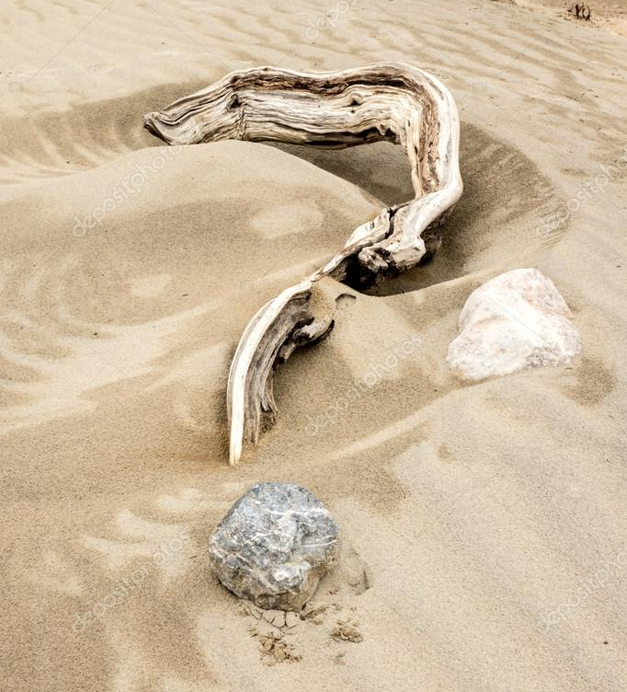
Questions?
Woodkern

Slide 29
Agenda
VI. Reports of Standing Committees
A. Budgetary Affairs
M. Fitch

Slide 30
Budgetary Affairs Committee
Oct 22, 2020
Referrals
Scholarship discount rate
Committee internal: ID card readers, Kummer Institute
Continuing referrals:
Report on the “big picture balance sheet”
Current and next FY budget

Slide 31
COVID money (ID card readers)
Financial target for each campus, items decided by System committee including two S&T finance employees
Funds = reimbursement for costs not originally budgeted
Limiting access to labs (and conference rooms) seen as critical in March
Document how many in room to avoid exceeding COVID limits
Also funding conference room equipment

Slide 32
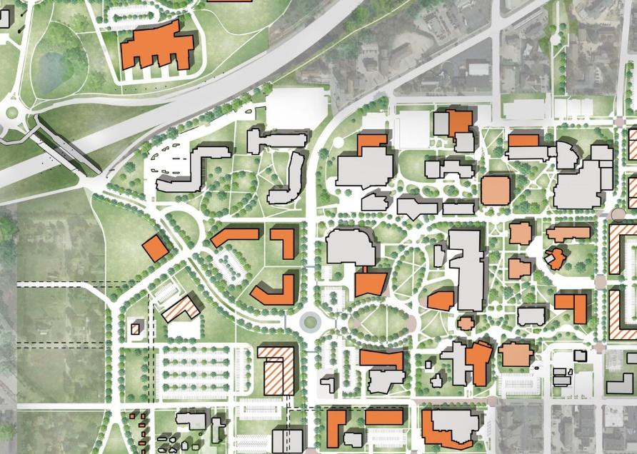
Kummer Institute Foundation (numbers approx.)
$430 MM Proposal
$300 MM gift (stock transferred)
$225 MM endowment
$75 MM
$10 MM annual
Institute director
Straumanis-James/ERL Addition
Student Experience Center
Systems Integration and Prototype Development Facility
Scholarships, fellowships
Research centers
Online degree expansion
Lecture series
Shuttle service
20 faculty (salary) ~ $2 – 3 MM

Slide 33
Kummer Institute Foundation (numbers approx.)
$430 MM Proposal
$300 MM gift (stock transferred)
$225 MM endowment
$75 MM
$10 MM annual
Institute director
Straumanis-James/ERL Addition
Student Experience Center
Systems Integration and Prototype Development Facility
Scholarships, fellowships
Research centers
Online degree expansion
Lecture series
Shuttle service
20 faculty (salary) ~ $2 – 3 MM
General operating budget
$1-1.5 MM benefit cost
$1.5 MM operating cost (2%)
$2-3 MM cut needed

Slide 34

Welcome Center & Entryway
Not Kummer Institute
$10 MM, VC Plain has pledged part

Slide 35
All Funds Budget: revenue
$8 MM accounting change nets zero, but
$4 MM increase in scholarship costs
 | FY19 | FY20 | FY21 (budgeted)
Tuition and Fees | $134,602,696 | $130,456,684 | $123,806,127
Scholarship Allowance | (52,410,261) | (64,966,612) | (62,236,470)
Net Tuition & Fees | $82,192,434 | $65,490,072 | $61,569,657
State Appropriation | 50,185,510 | 43,543,499 | 43,560,524
Grant and Contract | 40,338,895 | 48,105,314 | 48,902,000
Gift Revenues | 7,522,979 | 3,031,199 | 6,164,295
Recovery of F & A | 14,039 | 430 | 0
Endowment & Investment Income | 9,326,040 | 9,604,262 | 9,082,208
Sales & Services Income | 21,769,025 | 17,634,555 | 19,141,165
Other Incomes | 4,619,518 | 8,414,083 | 4,497,816
Revenue Contingency | - | - | (938,512)
Total Revenues | $215,968,442 | $195,823,416 | $191,979,152
$6.6 MM drop
$2.7 MM lower cost
Fear of withholding
$1.5 MM rebound estimated
Internal withhold
$3.85 MM cut
$11.7 MM cut planned,
where’s $7.85 MM?
$4 MM decrease = sent home (dorms, dining)

Slide 36
All Funds Budget: costs
Total Revenues | $215,968,442 | $195,823,416 | $191,979,152
Transfers | FY19 | FY20 | FY21 (budgeted)
Intra Unrestricted CurrentFund | $968,016 | $4,220,348 | $106,060
Mandatory Transfers | (10,718,936) | (11,384,016) | (11,559,318)
NonMandatory Transfers | (14,361,580) | (10,630,586) | (413,847)
Total Transfers | ($24,112,501) | ($17,794,253) | ($11,867,106)
Expenditures
Salaries & Wages | $106,061,187 | $102,581,750 | $99,824,540
Benefit Expense | 30,532,226 | 30,384,639 | 32,000,257
Compensation | $136,593,413 | $132,966,389 | $131,824,796
Other_Expenses | 57,209,262 | 47,944,226 | 47,340,424
Total Expenditures | $193,802,675 | $180,910,615 | $179,165,220
Total Expenditures + Transfers | $217,915,176 | $198,704,868 | $191,032,326
Paying loans on dorms, geothermal, Bertelsmeyer
$2.76 MM cut
Benefit cost growth, layoff costs
$0.94 MM ‘withhold’

Slide 37
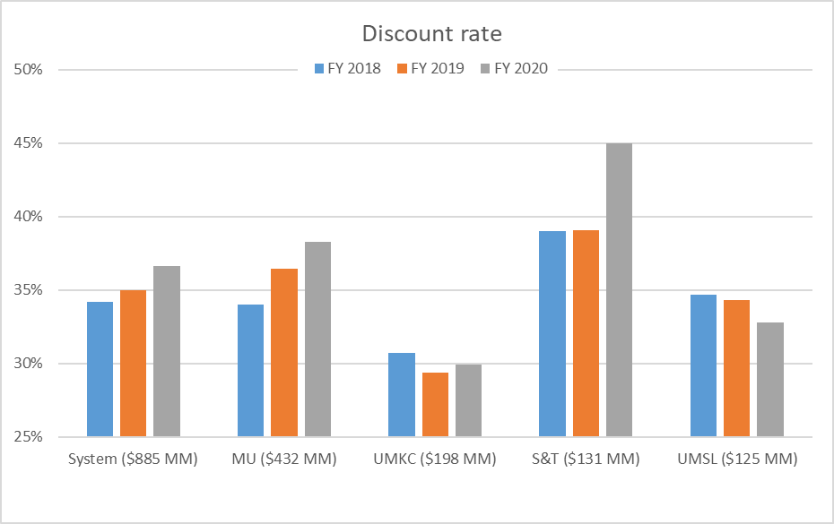
Tuition discount rate comparison
Proportionally more students receive
Merit-based scholarships
Need-based scholarships
Financial aid strategies: developed by Enrollment Mgt with assistance from consultants, CFO/Provost/Chancellor review and approve.
Data: Budget Book, UM System 2020 Budget
Uses different ‘all funds’ than past slides

Slide 38
Agenda
VI. Reports of Standing Committees
B. Curricula
S. Raper

Slide 39
CCC Meetings
  7 October
  28 October (upcoming)
Total Committee Activity
  10 Program change request (PC forms)
  24 Course change requests (CC forms)
  2 Experimental course requests (EC forms)

Slide 40
Program Changes (PC) Requested
  File: 255.16 BUSAPPS-MI : Business Applications and Software Development Minor
  File: 58.19 FINANCE-MI : Finance Minor
  File: 81.9 MARKET-MI : Marketing Minor
  File: 363 PROPOSED : Human Factors Psychology
  File: 329.2 FIN ENG-CT : Financial Engineering CT
  File: 360 PROPOSED : Mine Reclamation CT
  File: 361 PROPOSED : Mining Project Evaluation CT

Slide 41
Degree Program Changes (DC) Requested
  File: 362 PROPOSED : Sustainability in Mining CT
  File: 366 PROPOSED : UCT - Logic and the Philosophical Foundations of STEM
  File: 367 PROPOSED : UCT - PROFESSIONAL ETHICS AND MORAL REASONING

Slide 42
Course Changes (CC) Requested
  File: 2470.1 ECON 4440 : Environmental And Natural Resource Economics
  File: 1747.4 ECON 4540 : Energy Economics
  File: 2086.4 EDUC 1104 : Teacher Field Experience I
  File: 1111.3 EDUC 2002 : Problems Of Teaching Social Studies
  File: 404.3 EDUC 2205 : Problems Of Teaching Science/Chemistry
  File: 1069.3 EDUC 2206 : Problems Of Teaching Science/Physics
  File: 513.3 EDUC 2207 : Problems Of Teaching English
  File: 1550.3 EDUC 2219 : Art For Elementary Teachers
  File: 2503.3 EDUC 2231 : Methods In Physical Education 5-9

Slide 43
Course Changes (CC) Requested
  File: 177.3 EDUC 3320 : Professional Development
  File: 1168.1 GEOLOGY 6551 : Global Tectonics and Metallogeny
  File: 1565.10 IS&T 1552 : Implementing Information Systems: Data Perspective
  File: 2391.9 IS&T 5335 : Fundamentals of Mobile Technology for Business
  File: 1034.1 IS&T 5445 : Database Marketing
  File: 4157.9 IS&T 5450 : Introduction to Information Visualization
  File: 4157.9 IS&T 5780 : Human and Organizational Factors in Cybersecurity

Slide 44
Course Changes (CC) Requested
  File: 2560.8 IS&T 5885 : Human-Computer Interaction and User Experience
  File: 75.5 IS&T 6336 : Internet Computing and the Internet of Things
  File: 4732 IS&T 6723 : Artificial Intelligence, Robotics, and Digital Transformation
  File: 4731 MKT 5410 : Big Data Consumer Analytics
  File: 4729 PHILOS 4665 : Creating Future Cities
  File: 4728 PHILOS 4666 : Technology, Ethics, and Philosophy
  File: 4725 PSYCH 3340 : Assessment of Student Learning
  File: 412.1 STAT 6545 : Multivariate Statistical Methods

Slide 45
Curriculum committee moves for FS to approve the PC and CC form actions
Discussion: Questions or comments?

Slide 46
For Informational Purposes; No Senate Approval Required
Experimental Course (EC) Requests
  File: 4735 ENGLISH 3001.008 : Pandemic Literature
  File: 4730 PHYSICS 4001.001 : Cosmology and Galaxies

Slide 47
Agenda
VI. Reports of Standing Committees
Library and Learning Resources
M. Bruening

Slide 48
2021
Library Materials Portfolio Review

Slide 49
Three Major Challenges
FY 21 library collections budget (GRA): 18% reduction
Subscription inflation: 3% estimated
A possible cancellation of Elsevier’s Freedom Collection (S&T needs to pick up highly used journals)

Slide 50
Fiscal Year 21 Budget
2020 GRA
$1,322,159.00
2021 GRA
$1,079,805.00
Library Reserves
$92,556.00
F&A Funds
$120,000.00
Total
$1,292,361.00
2021 Total Expenditures @ 3% Inflation
$1,666.908.00
Estimated Shortfall (as of Oct, 2020)
-$374,547.00
Library reserves funds are one-time monies.
Projected expenditures assume 3% inflation except when set by contract, FY21 cost is already known, or historical data can reliably be used to estimate inflation.

Slide 51
UM System Cuts for FY21
10 resources:
  US Congressional Serial Set
  Reader's Guide Retrospective
  JSTOR Ecology & Botany collection
  Oxford Life Science package
  British Medical Journal
  Nursing II package
  Mergent Archive
  GeoRef
  America History and Life
  Historical Abstracts
GeoRef was picked up by S&T library through endowment funds for FY 21.

Slide 52
Elsevier, ScienceDirect, and the Freedom Collection
All other campuses in the UM system cut their spending on individual Elsevier subscriptions this year.
  Estimates from the other three campuses suggest that they are all planning to cut subscriptions by approximately 33%.
The Freedom Collection was tied to individual subscriptions, so access to its 2,500 titles will be lost in 2021.
  Loss of access includes all content from 2000-present.
Missouri S&T will also cut individual subscriptions to cover our campus shortfall.

Slide 53
Missouri S&T Elsevier Subscription Cuts
Missouri S&T currently subscribes to 61 journals for $370k.
We will keep 9 of those titles, while cutting the rest to add the most highly used Freedom Collection journals.
Based on current projected pricing, we are expecting to add 22 new journal subscriptions.
Estimated total cost for the subscriptions after cuts and adds is approximately $266k, a 28% cut.
Negotiations with Elsevier are continuing, so the final cost is unknown at this time.
ILL costs will also go up with the loss of access.

Slide 54
Latest Proposal from Elsevier (as of Oct. 12)
Each UM campus would cut 10% of its Elsevier local subscriptions
Retain the Freedom Collection at the UM System level—for a fee
Challenge: S&T and the other campuses will not be able to find budget to support this idea.
FY 20: S&T paid $370k for subscriptions plus $64k for the Freedom Collection

Slide 55
Complexity of Subscription Pricing
One ebook package’s FY 20 cost: $33K
Planned to cut some subject collections costing $10K for FY 21
With cuts, vendor’s proposed pricing was $77K after cancellations
Final deal: with no cuts and a partnership with Mizzou S&T pays $33K for FY 21 with 15 months of coverage
Challenge: where to cut $10K as planned?

Slide 56
Factors Considered for Proposed FY21 Cuts
A cost per use (CPU) of $10 and over, with some exceptions due to the specialized nature of the resource
Availability through interlibrary loan
Contractual obligations
The potential for “unbundling” packages and subscribing to individual journals

Slide 57
Agenda
VI. Reports of Standing Committees
D. Academic Freedom and Standards
K. Kosbar

Slide 58
Academic Freedom & Standards Committee
Maximum Academic Load
K. Kosbar
Chair AF&S Committee
10/22/20
Rev 3

Slide 59
Current regulations make it unclear if there is a cap on the number of credit hours students may enroll in per semester, per session, or in concurrent sessions
Current regulations are unclear how much contact time students should expect per credit hour, and how much preparation/study time is required

Slide 60
S&T has 3 semesters (a.k.a. terms) per year
  Spring, Summer, Fall
Each semester may have multiple sessions
  16 week, 8 week, 4 week, 2 week
Sessions may be offered concurrently, or consecutively

Slide 61
Current regulations limit the number of hours in an “undergraduate schedule”, without specifying if the limit applies to a semester, a session, or a group of concurrent sessions
Current regulations define a “credit hour” as “16 classroom hours” or 48 “laboratory hours”

Slide 62
Current regulations do not define “classroom hour” or “laboratory hour”
  3 credit hour, 16-week session, MWF class meets 43 times for 50 minutes, plus a two-hour final exam has 2,270 minutes of contact time, or 12.61 hours of contact time per credit hour
  1 credit hour, 16-week session, laboratory class which meets 110 minutes once a week, plus a two hour final exam uses 15.66 hours of contact time per credit hour.

Slide 63
Current regulations do not mention how much time students should expect to spend outside of the classroom/lab studying for a course.

Slide 64
S&T
  “undergraduate schedule” caps (16-week sessions?)
  19 hrs regardless of GPA, and without special approval
  20 hrs with GPA over 2.500 + Advisor Approval
  21 hrs with GPA over 2.750 + Advisor Approval
  22 hrs with GPA over 3.150 + Advisor Approval
  Unlimited with department chair approval

Slide 65
Mizzou
  Fall/Spring Semesters (16-week sessions?)
    17 hrs without special approval
    18 hrs with approval of Associate Dean for Academic Affairs
  Summer Session (8-week sessions?)
    6 hrs without special approval
    9 hrs with approval of Associate Dean for Academic Affairs

Slide 66
UMSL
  (16-week sessions?)
  18 hrs without special approval
  Unlimited with approval of Dean

Slide 67
UMKC
  (16-week sessions?)
    17 hrs without special approval
    Unlimited with approval of “academic unit”
  Summer semesters (8-week sessions?)
    8 hrs without special approval
    Unlimited with approval of “academic unit”

Slide 68
  Proposal from AF&S
Stop using GPA to calculate maximum academic load
Explicitly specify maximum academic load for 16, 8, 4 and 2 week sessions
Clearly specify the time commitment for credit hour of work, including time spend outside of the classroom/lab
Specify limits for overlapping sessions
Limit the number of credit hours from short (8/4/2 week) sessions toward an undergraduate degree

Slide 69
Motion #1 - Maximum Academic Load
Whereas,
Students need to allocate sufficient time to prepare, attend, and study for their classes
Whereas,
Instructors may feel pressure to lower the quality and scope of courses when their students have insufficient time to devote to their class
Whereas,
Students need time for non-academic pursuits and obligations
(motion continues on next page)

Slide 70
Whereas,
Current regulations arguably limit student academic load for 16-week sessions, but are silent on the limits for shorter sessions, and overlapping sessions
Resolved,
That the S&T Faculty Senate approves the following changes to the S&T Student Academic Regulations (strike-out text to be removed, and underlined text to be added)
(motion continues on next page)

Slide 71
III. Schedules / A. Definition of Credit Hour and Grade Point
A credit hour is the credit obtained for satisfactorily passing course of approximately 16 classroom hours. Three laboratory hours are considered the equivalent of one classroom hour.
A credit hour is the credit obtained from passing a course requiring approximately 800 minutes of instructional time during a session. Students may need to spend an additional 1,600 minutes preparing and studying, for a total time commitment during the session of 2,400 minutes.
During a 16-week session, this time is normally divided into 50 minutes of instruction per week, and 100 minutes of preparation/studying time per week, for lecture courses. Laboratory and experiential learning courses may choose a different balance between instructional and preparation/study time, but the total time commitment will still be approximately 2,400 minutes per session.
(motion continues on next page)

Slide 72
B. Permissible Schedules
The normal undergraduate schedule consists of not more than 19 credit hours. If the student has a grade point average of 2.500 or higher (see Section VIII.H, Determining Scholastic Standing) they may, with the permission of his/her advisor, take extra hours according to the following schedule:
• Cumulative GPA 2.500 or above - 1 extra hour
• Cumulative GPA 2.750 or above - 2 extra hours
• Cumulative GPA 3.150 or above - 3 extra hours
For additional hours or for any schedule exceeding 23 hours, including military courses, the student must petition their department chair.
(motion continues on next page)

Slide 73
Undergraduate academic schedules should not require a student to spend more than 3,000 minutes in any week to prepare for, attend, and study for their courses. If the student is enrolled in a single session at a time, this will translate to a maximum number of credit hours of:
• 20 credit hours during a 16-week session
• 10 credit hours during an 8-week session
• 5 credit hours during a 4-week session
• 2 credit hours during a 2-week session
(motion continues on next page)

Slide 74
If a student is simultaneously enrolled in a 4-week and 16-week sessions, the following limits apply
• 1 credit hour in the 4-week session limits the 16-week session enrollment to 16 credit hours
• 2 credit hours in the 4-week session limits the 16-week session enrollment to 12 credit hours
• 3 credit hours in the 4-week session limits the 16-week session enrollment to 8 credit hours
• 4 credit hours in the 4-week session limits the 16-week session enrollment to 4 credit hours
• 5 credit hours in the 4-week session prohibits simultaneous enrollment in a 16-week session
Students schedules which exceed these limits require the permission of the student's academic advisor, and chair of the advising department.
(end of motion #1)

Slide 75
Motion #2 - Limiting Degree Credit from Short Sessions
Whereas,
Sessions shorter than 16-weeks can provide valuable options to students and instructors
Whereas,
The rapid pace of instruction used in short sessions can make it a challenge for students to fully comprehend and appreciate the course content
(motion continues on next page)

Slide 76
Resolved,
That the S&T Faculty Senate approves the following addition to the S&T Student Academic Regulations:
III Schedules
E. Credit Required for a Degree
3. Limits on Short Sessions
Undergraduate students may not normally use more than 60 credit hours taken in sessions shorter than 15 weeks toward their Bachelor's degree. In addition, there may be no more than 30 credit hours from sessions shorter than 7 weeks, and no more than 15 hours from sessions shorter than 3 weeks in length. All limits may be increased by up to 20% with approval of the student's academic advisor and chair of the advising department.
(end of motion #2)

Slide 77
Comments from S&T Registrar (paraphrased)
Limiting 16/8/4/2 week session enrollment to 20/10/5/2 credit hours can be implemented with current software.
Implementing enrollment caps that consider enrollment in consecutive, or concurrent, sessions is a problem.
The semester, but not the session, a course was completed is captured. Implementing a graduation requirement that limits credit hours by length of session is a problem.

Slide 78
Plan to present motions at 11/19/20 Faculty Senate meeting
Send comments to AF&S committee:
  Kurt Kosbar (chair), kosbar@mst.edu
  Islam El-Adaway, eladaway@mst.edu
  Patrick Huber, huberp@mst.edu
  Matt Install, insall@mst.edu
  Douglas Ludlow, dludlow@mst.edu
  Jagannathan Sarangapani, sarangap@mst.edu
  Chris Verbrugge, cv27f@mail.umkc.edu

Slide 79
Agenda
VII. Reports of AdHoc Committee
A. Bylaws Committee
T. Schuman

Slide 80
Bylaws Committee Report
Tom Schuman (chair)
Committee members:
Levent Acar, Michael Bruening, Michael Davis, Bill Fahrenholtz, Mark Schlesinger, Sahra Sedigh, Kris Swenson, Ben Trachtenburg (ex officio, Mizzou)

Slide 81
Process
Committee members wrote/edited bylaws sections
Chair compiled the members’ versions into one document
Held meetings to discuss and eventually vote on edits
Send for feedback
  Senate and faculty
  UM System and Rolla campus, Admin and Student organizations
Final committee meeting to finalize version
Faculty vote
UM System and Curator vote for approval and adoption

Slide 82
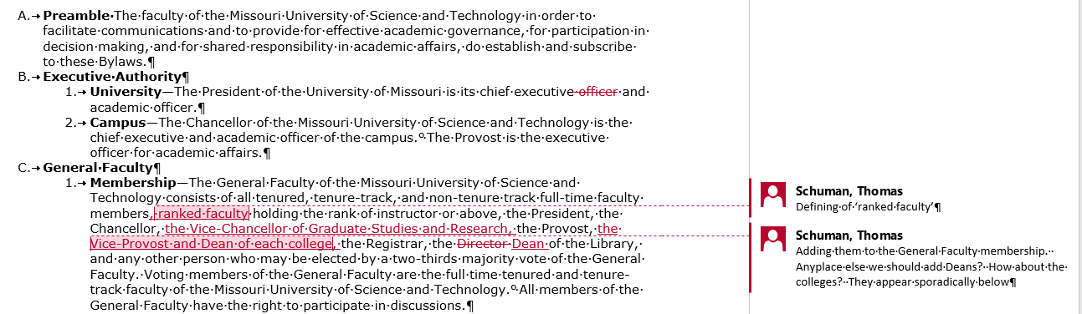
Redline review

Slide 83
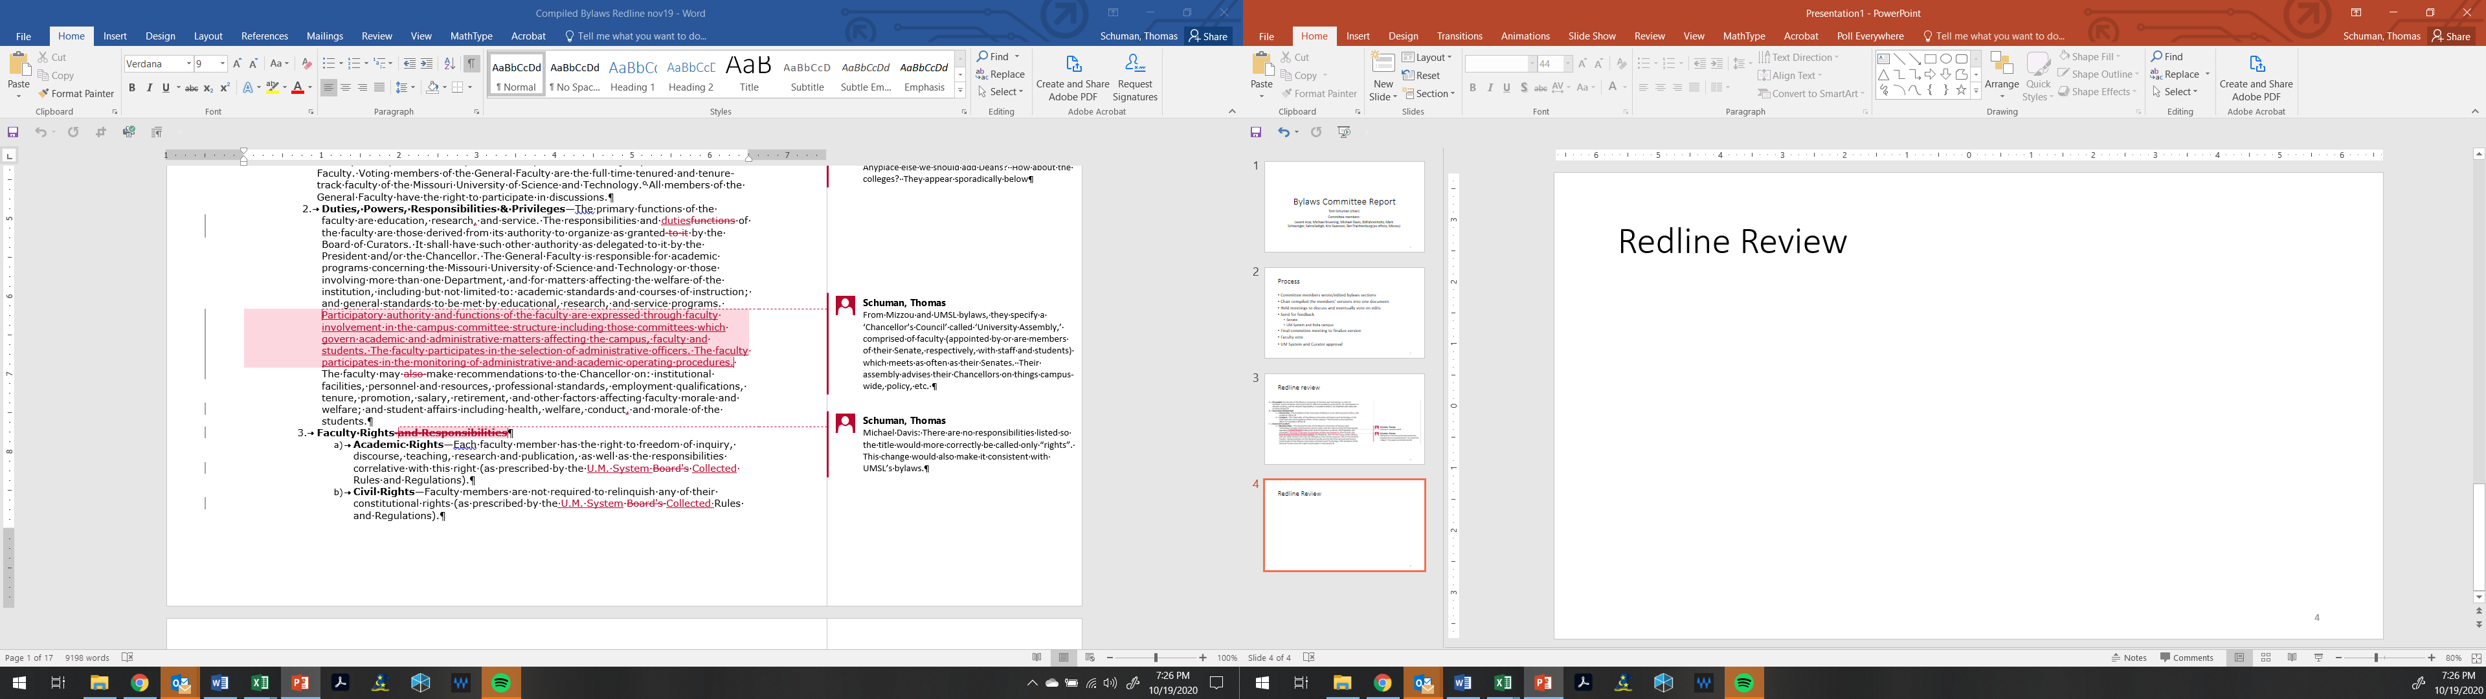
C. General Faculty
Throughout document there was a unification of how to refer to UM System Bylaws:
e.g., “(as stated in the U.M. System Board's Collected Rules and Regulations).”

Slide 84
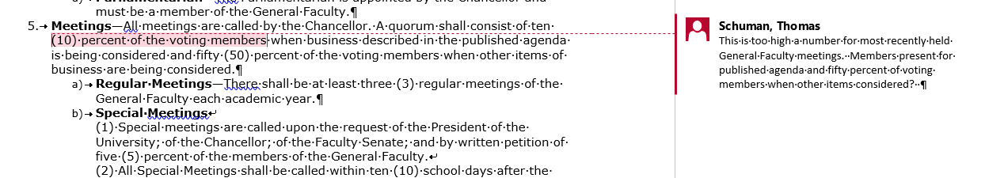
C. General Faculty

Slide 85
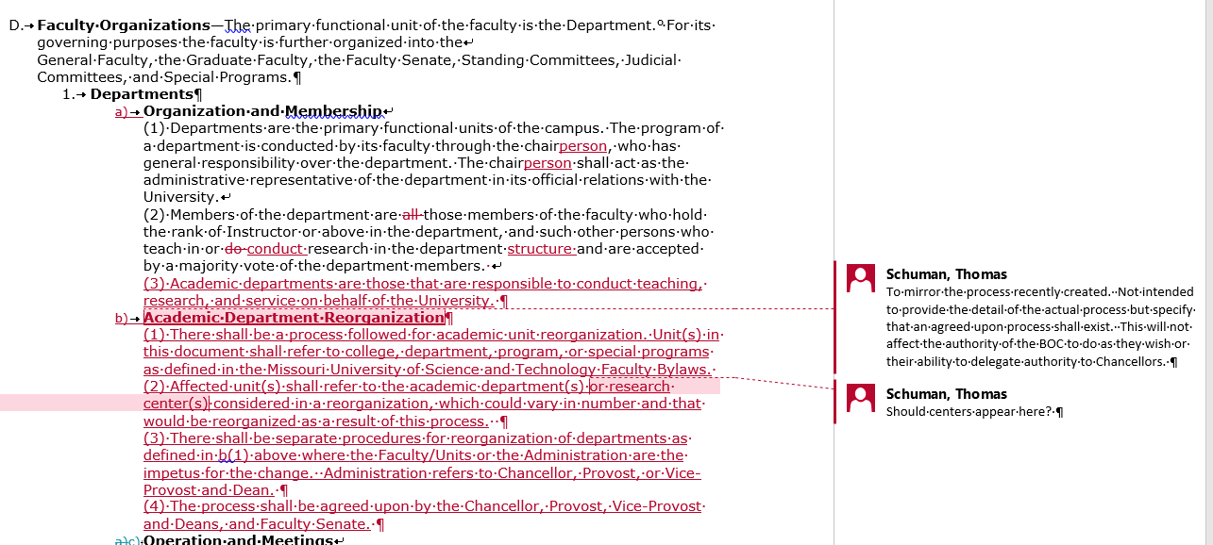
D. Faculty Organizations

Slide 86
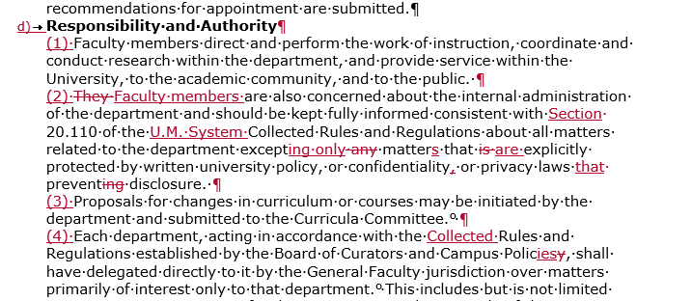
D. Faculty Organizations

Slide 87
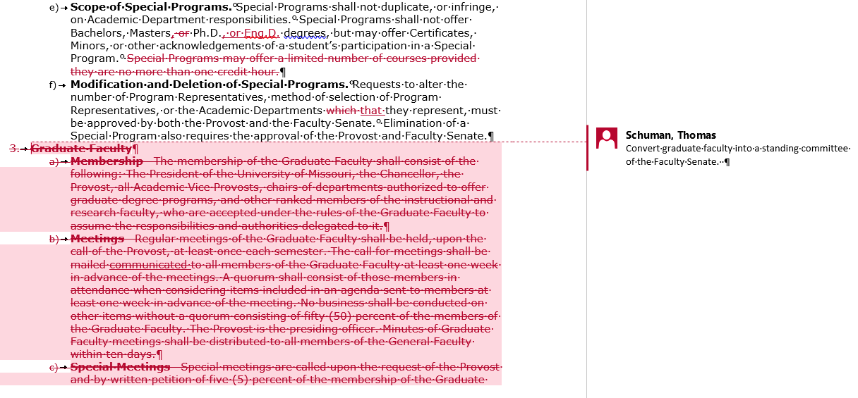
D. Faculty Organizations

Slide 88
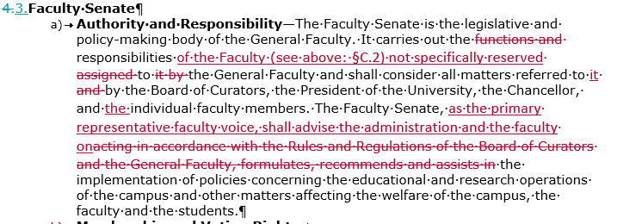
D. Faculty Organizations
C.

Slide 89
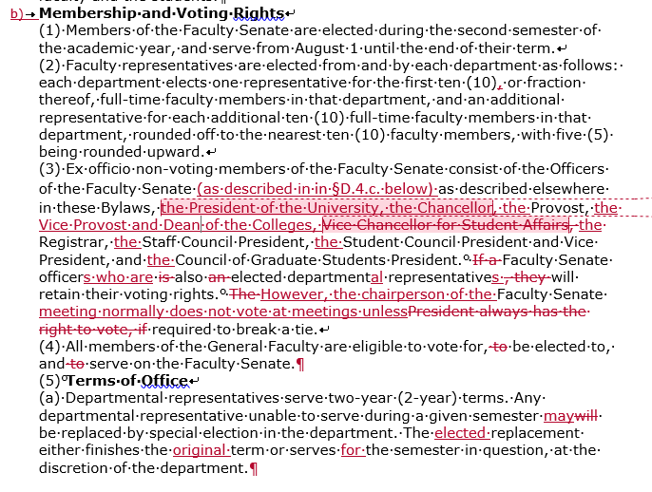
D.3. Faculty Senate

Slide 90
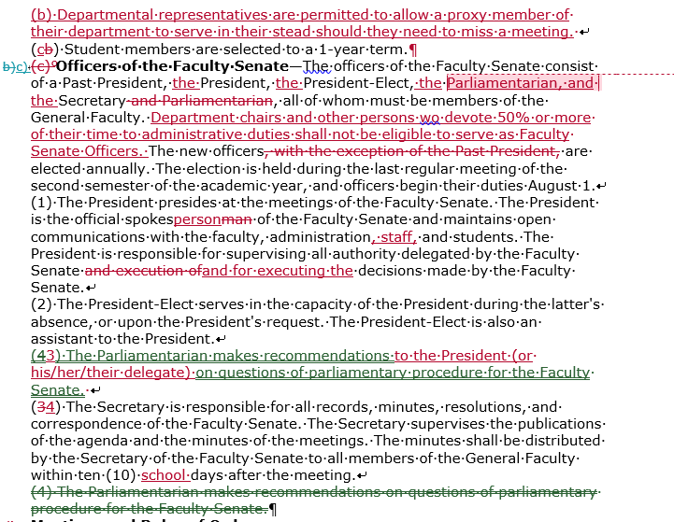
D.3. Faculty Senate

Slide 91
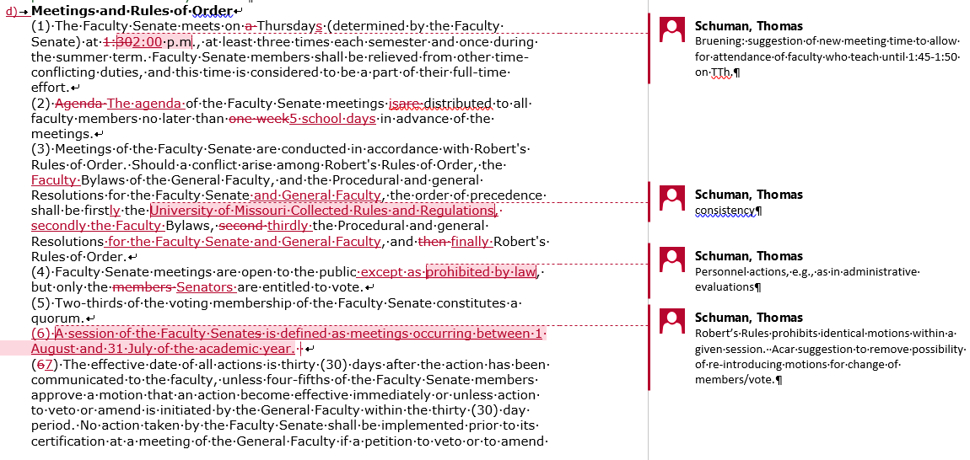
D.3. Faculty Senate

Slide 92
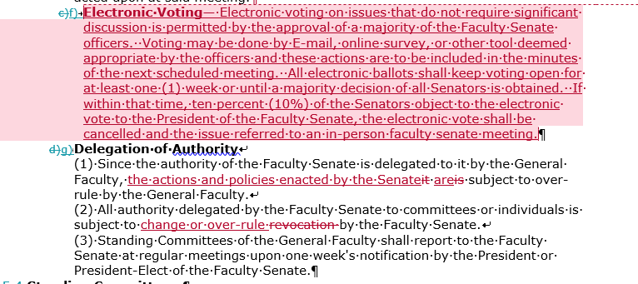
D.3. Faculty Senate

Slide 93
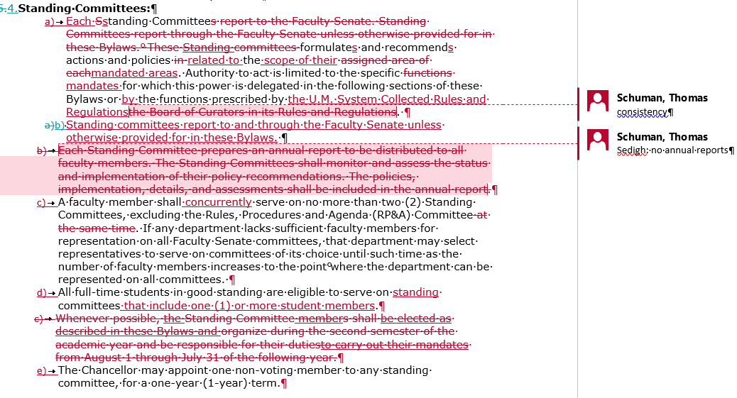
D.4. Standing Committees
Moved to section g. below

Slide 94
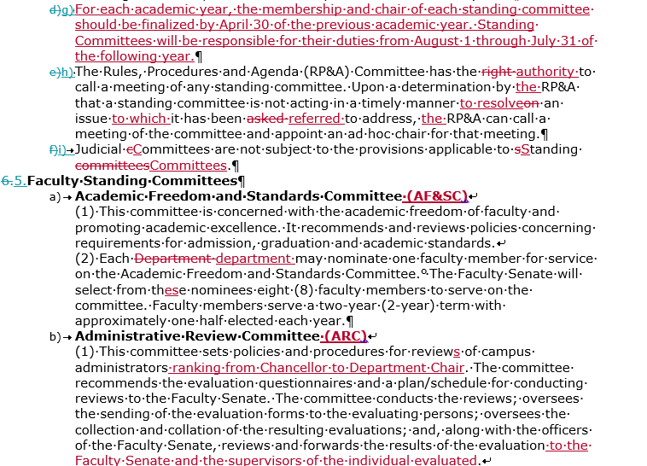
D.5. Faculty Standing Committees

Slide 95
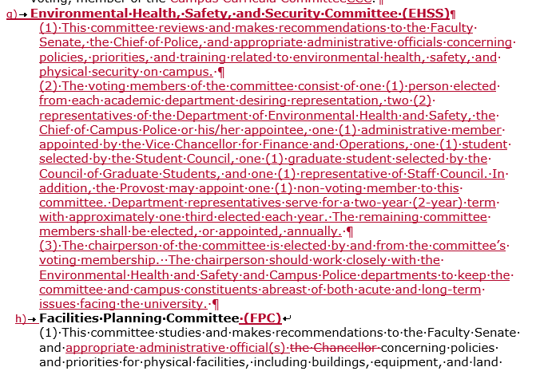
D.5. Faculty Standing Committees

Slide 96
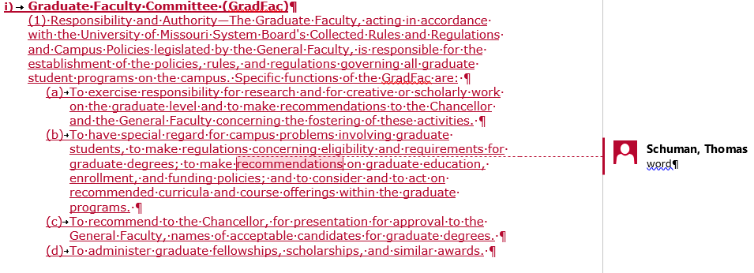
D.5. Faculty Standing Committees

Slide 97
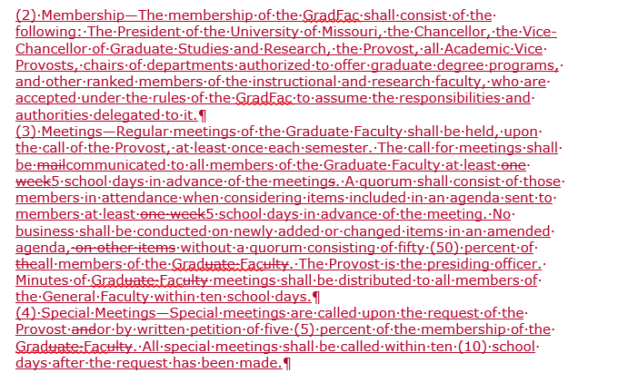
D.5. Faculty Standing Committees

Slide 98
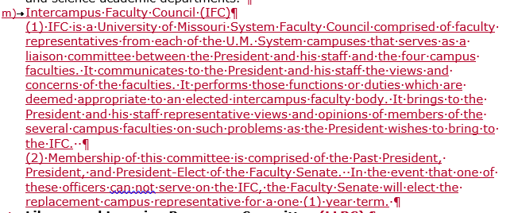
D.5. Faculty Standing Committees

Slide 99
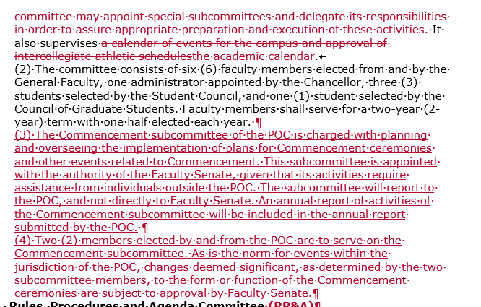
D.5.f. Public Occasions Committee (POC)

Slide 100
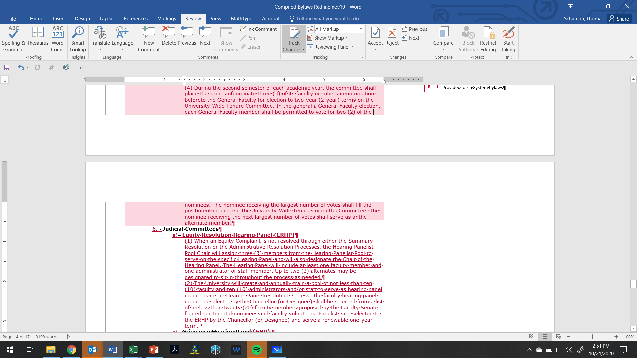
D.5. Faculty Standing Committees

Slide 101
D.6. Judicial Committees

Slide 102
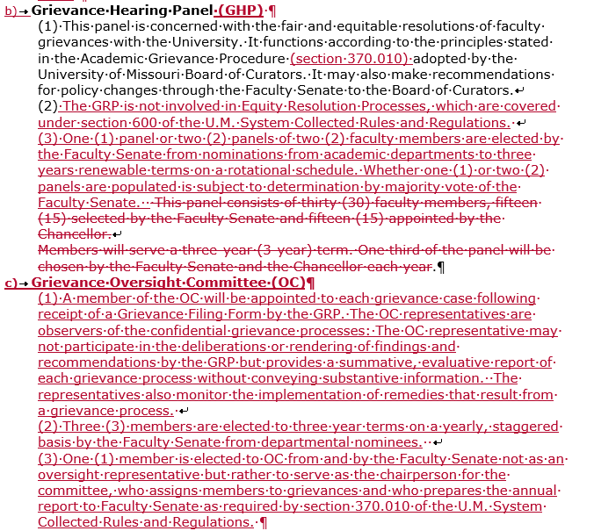
D.5. Judicial Committees

Slide 103
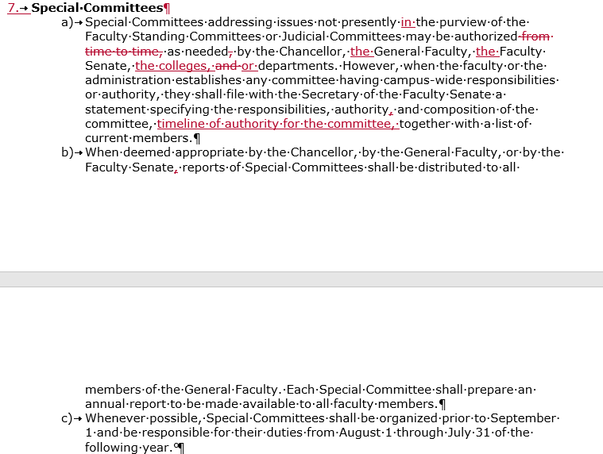
D.7. Special Committees

Slide 104
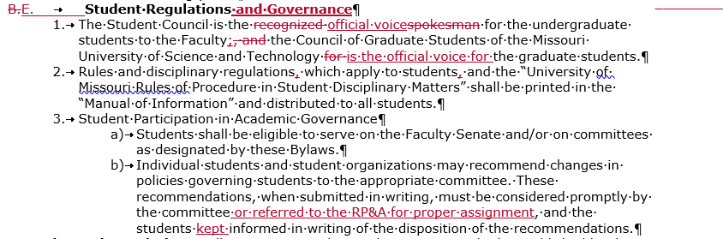
E. Student Regulations and Governance

Slide 105
Agenda
VIII. New Business

Slide 106
Agenda
IX. Adjourn
106

